Slide 1


Mid Project Presentation
Marketing campaigns

Slide 2
Objective:
The objective of this analysis is to Classify customer response to marketing campaigns. by focusing on the "response" variable, we aim to identify factors that influence whether a customer engages positively with a campaign, such as making a purchase or signing up for a service. this predictive modeling will enable us to optimize future campaigns and target audiences more effectively.

Slide 3
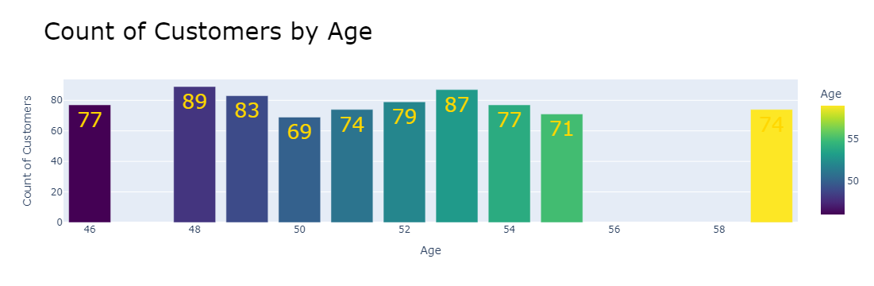
1.Customers Demographics:
Insight (1):
Our Customer’ Ages range from 30 till 100 But the Top 10 Count of Customers Came in Range 46 – 59 years old

Slide 4
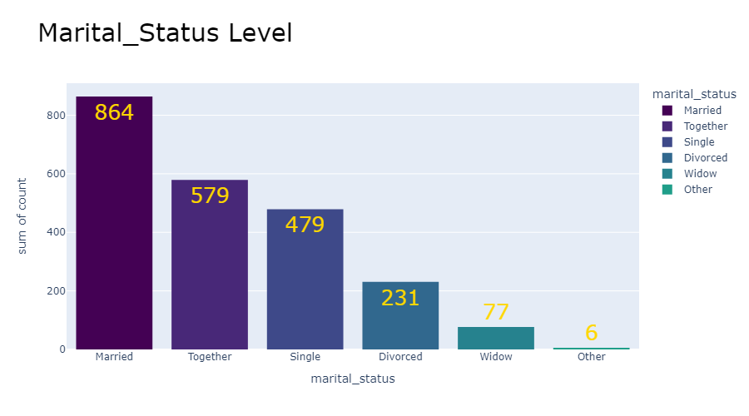
Insight (2):
Married Customers record the Highest with 864 ones , then Came Together with 579

Slide 5
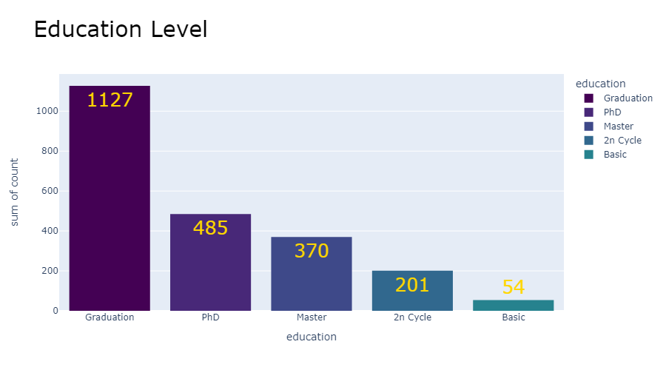
Insight (3):
Graduation ones record the Highest records with 1227 Customers.

Slide 6
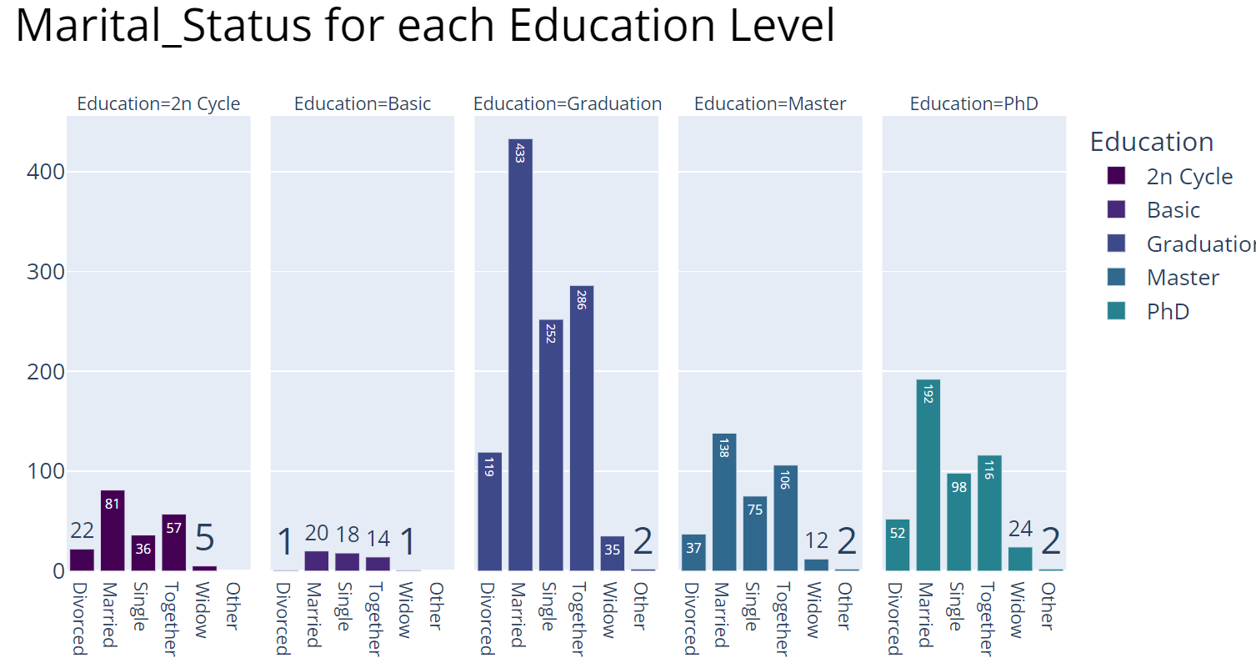
Insight (4):
The most of our customers are Married & Graduated with 433 Customers,
Also, the most records came from “Graduation” with different Marital status.

Slide 7
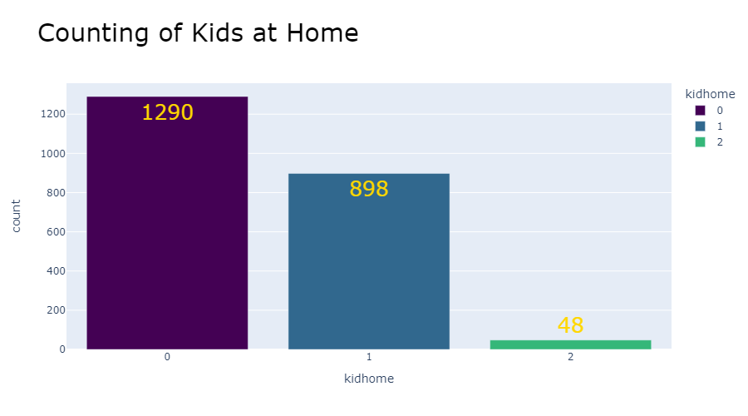
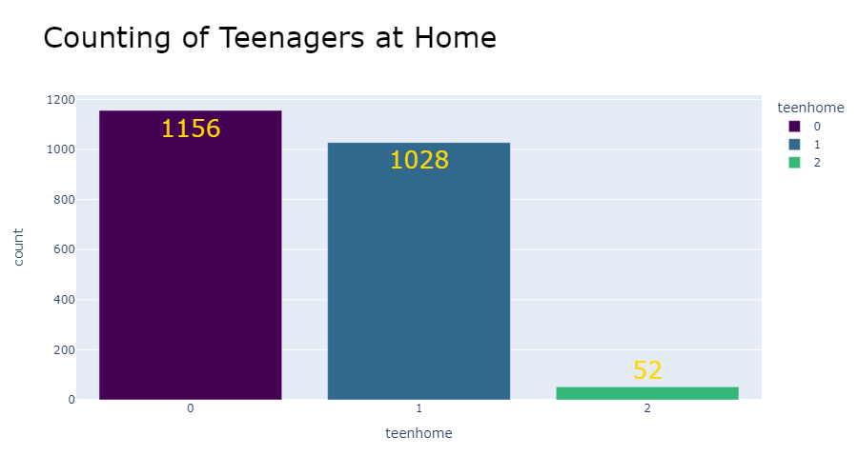
Insight (5):
Customers That have no-kid and have no-teenagers recorded the Highest in our Company with 1290 , 1156 .

Slide 8
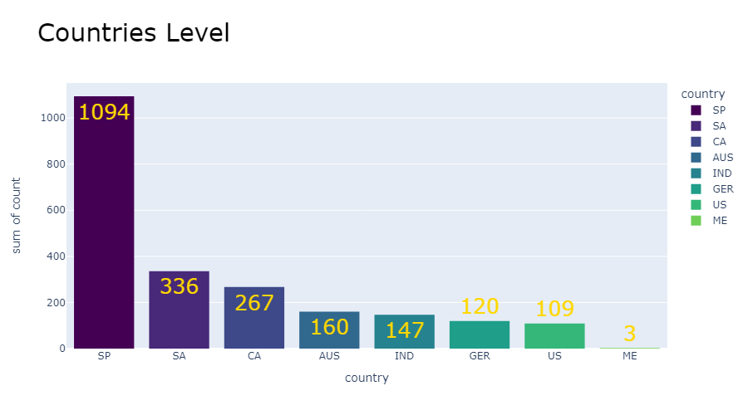
Insight (6):
Customers That Lived in (Spain) recorded the Highest in our Company with 1094.

Slide 9
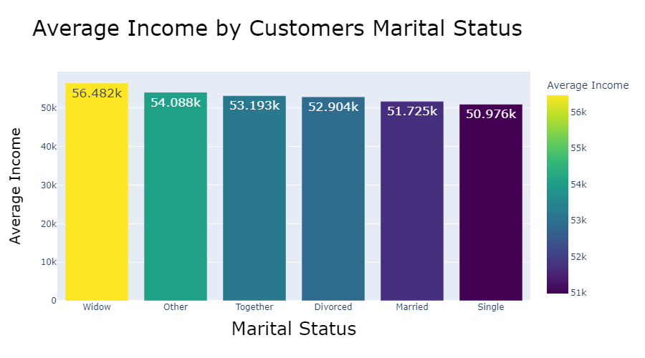
2.Income:
Insight (7):
Widow Customers recorded the Highest Average of Annual income with 56.482k Dollars.

Slide 10
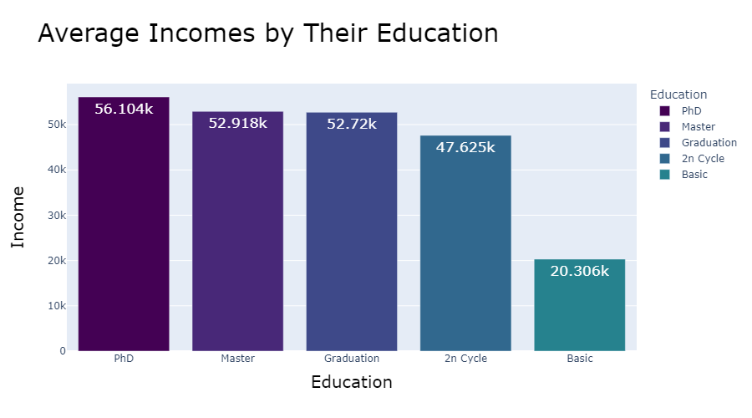
Insight (8):
PhD Customers recorded the Highest Average of Annual income with 65.104k Dollars.

Slide 11
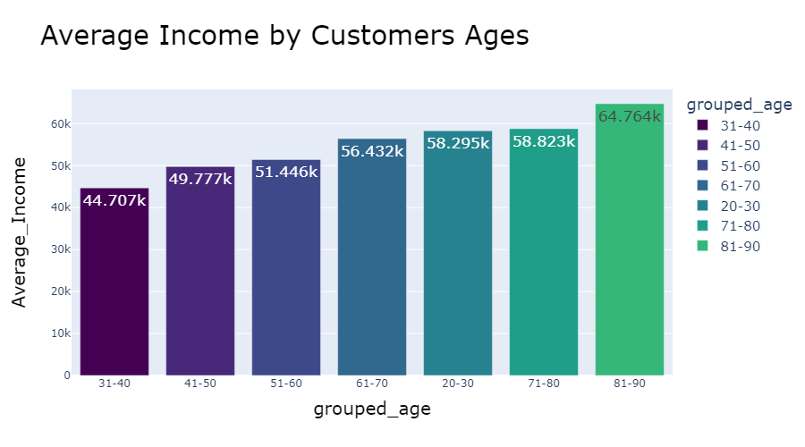
Insight (9):
Grouped age of Customers 80-90 recorded Highest Average of Annual income in with 64.764k Dollar.

Slide 12
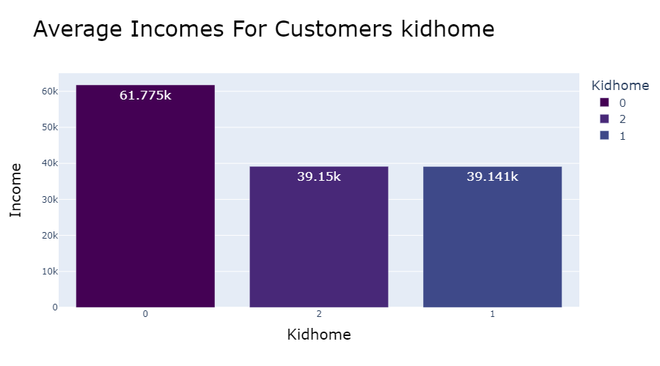
Insight (10):
Customers that have no kids in Home recorded the Highest Annual Income with 61.755k.

Slide 13
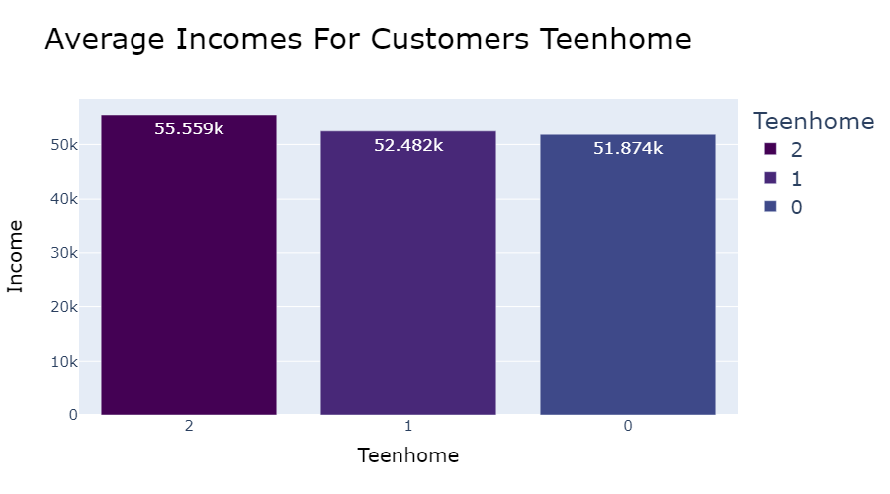
Insight (11):
Customers that have 2 teenagers in Home recorded the Highest Annual Income with 55.559k.

Slide 14
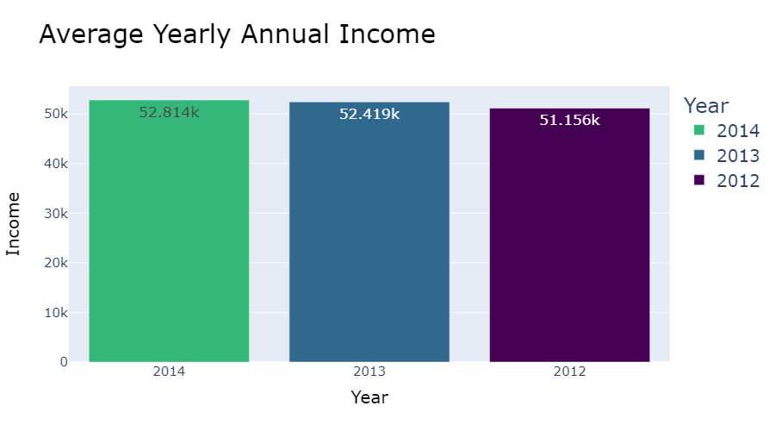
Insight (12):
Year 2014 records the highest Annual Average Income of Customers that enrolled to our Company with 52.814k.

Slide 15
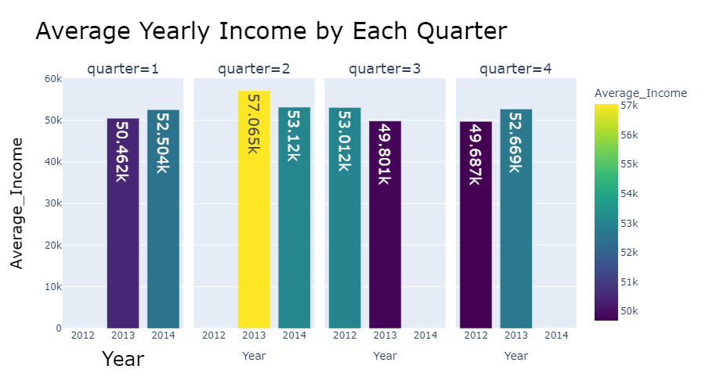
Insight (13):
Highest Average of Annual income of Customers that Enrolled in our company made in 2013, Quarter (2) with 57.065k .

Slide 16
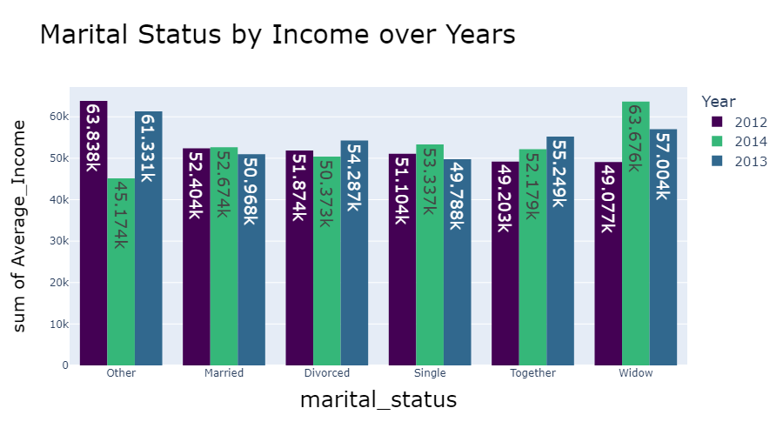
Insight (14):
In 2012 the highest average Income came from Customers that Marital status : other .
In 2014 the highest average Income came from Customers that Marital status : Widow.
In 2013 the highest average Income came from Customers that Marital status : other.

Slide 17
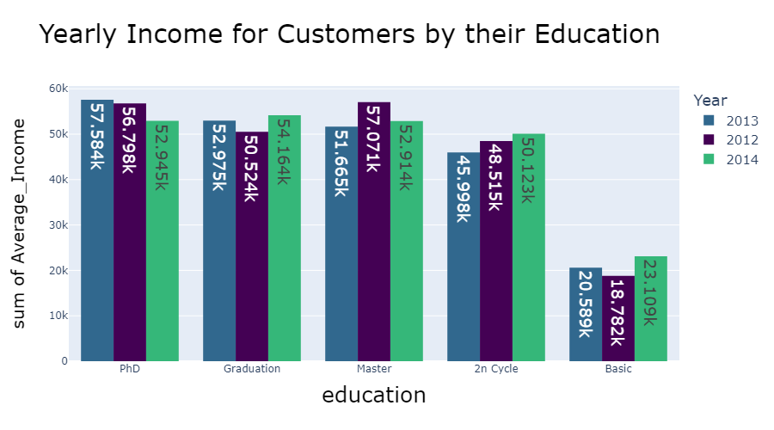
Insight (15):
In 2013 Highest Average Income came from Customers that had Education Degree : PhD
In 2012 Highest Average Income came from Customers that had Education Degree : Master
In 2014 Highest Income came from customers that had Education level : Graduation

Slide 18
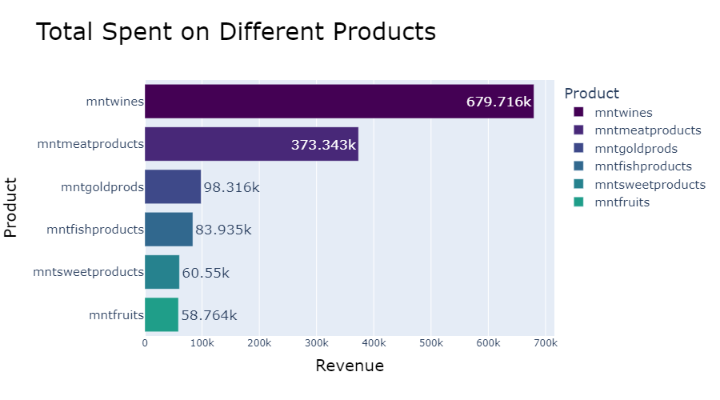
3.Product Revenue:
Insight(16):
Revenue of Wine Product Recorded the Highest Amount with 679.716k , then Meat with 373.343k .

Slide 19
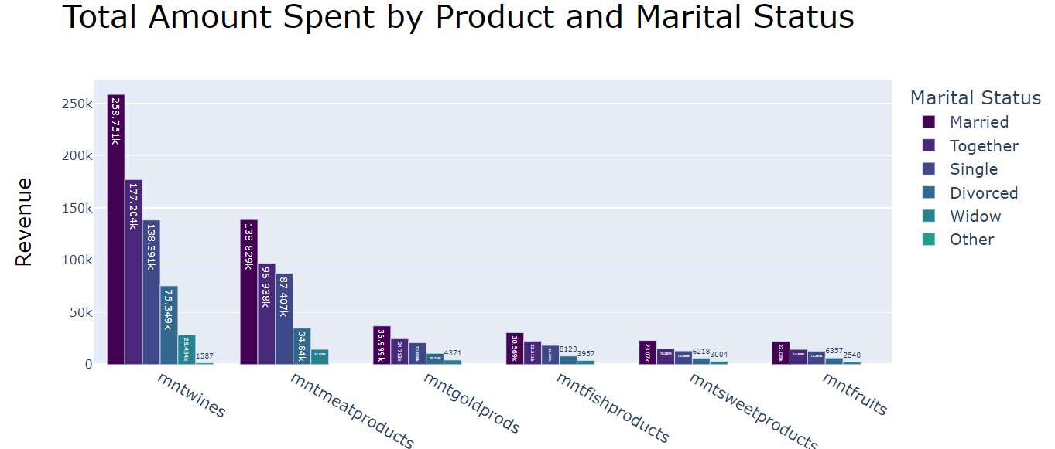
Insight(17):
Married Customers made Highest Revenue of All Products, then Together Customers and Finally Single.

Slide 20
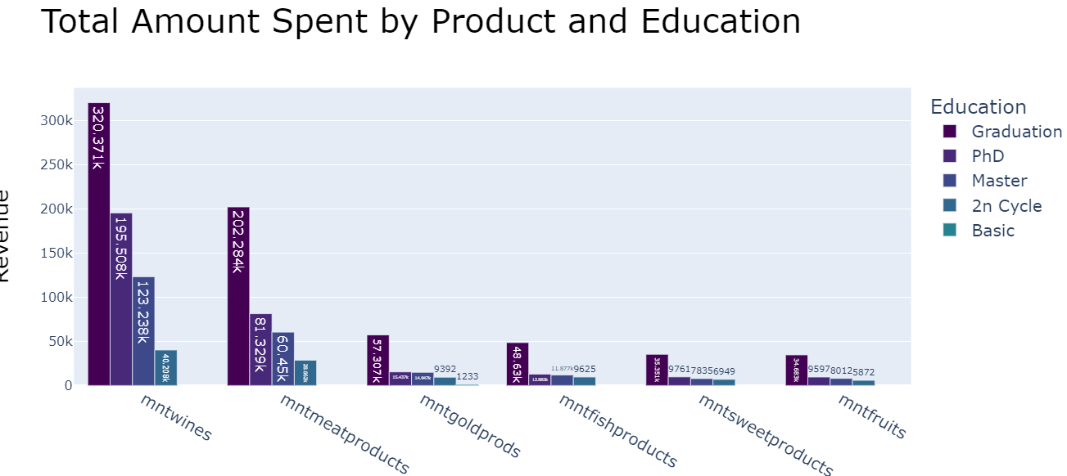
Insight(18):
Graduation Customers made Highest Revenue of all Products , then PhD Customers.

Slide 21
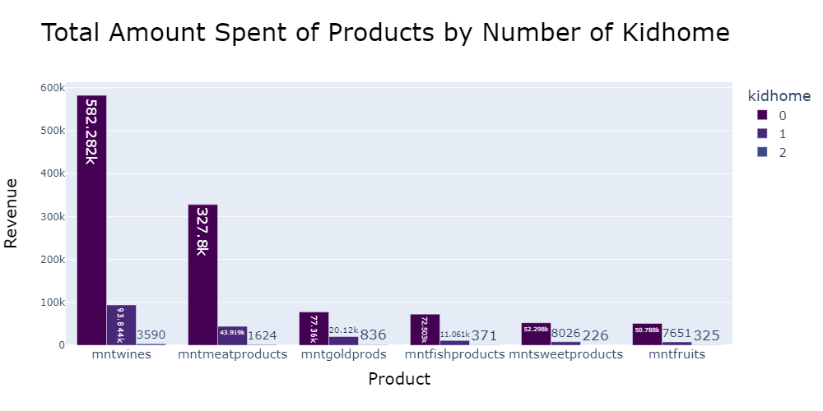
Insight(19):
Customers that have no kidhome recorded the Highest Revenue for all Products.

Slide 22
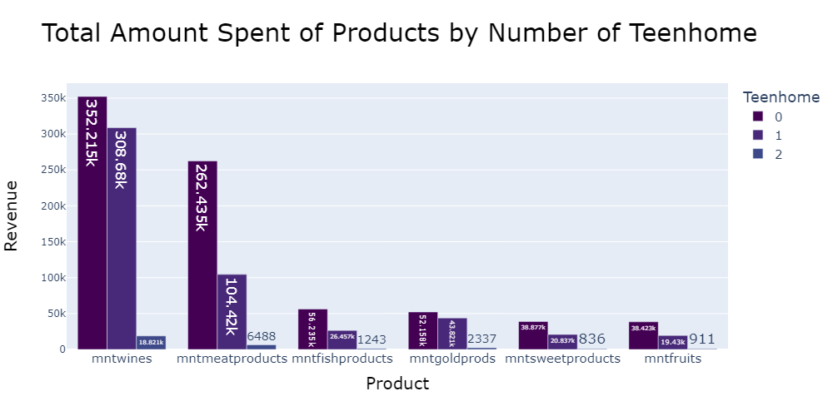
Insight(20):
Customers that have no Teenhome recorded the Highest Revenue for all Products,
Then Customers with 1 Teenhome came.

Slide 23
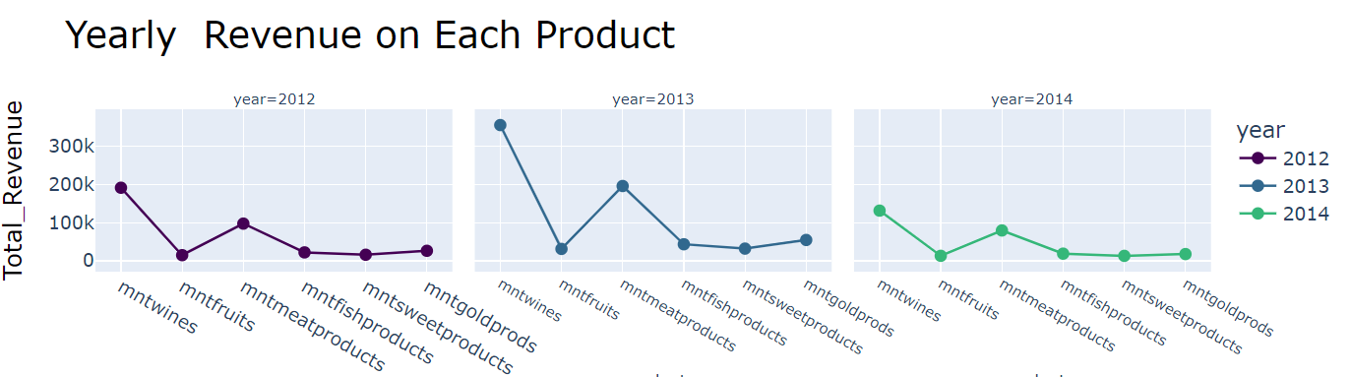
Insight(21):
As we see 2013 Recorded the Highest Revenue with Wine Product then Meat .

Slide 24
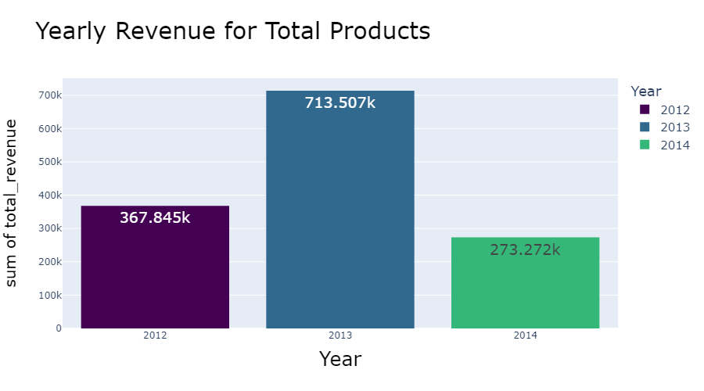
Insight(22):
Credit went to Year 2013 that Recorded the Total Revenue for All products.

Slide 25
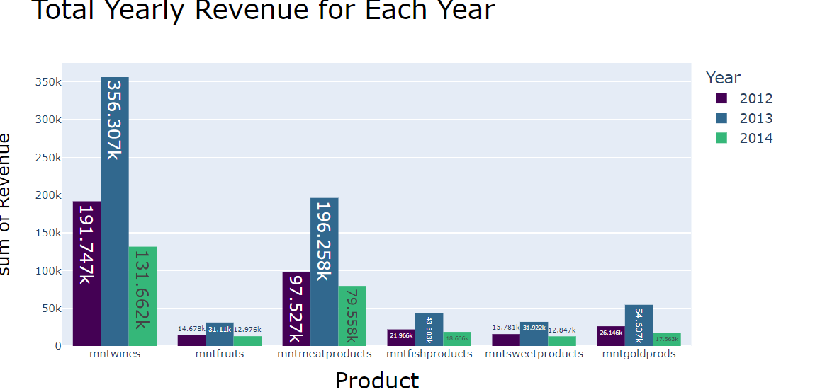
Insight(23):
As we see 2013 Recorded the Highest Revenue in All Products ,, then 2012 , and Finally 2014.

Slide 26
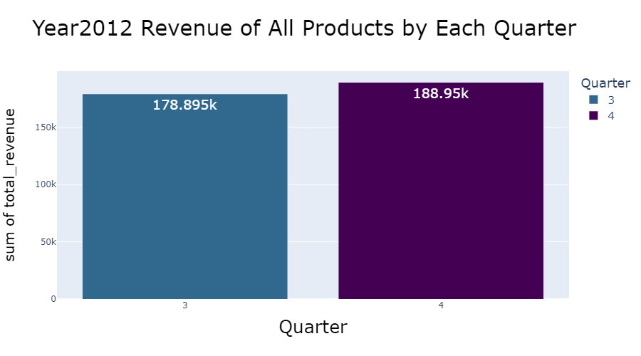
Year (2012)
Insight(24):
In Year 2012 : Quarter (4) Recorded the highest Revenue for total Products.

Slide 27
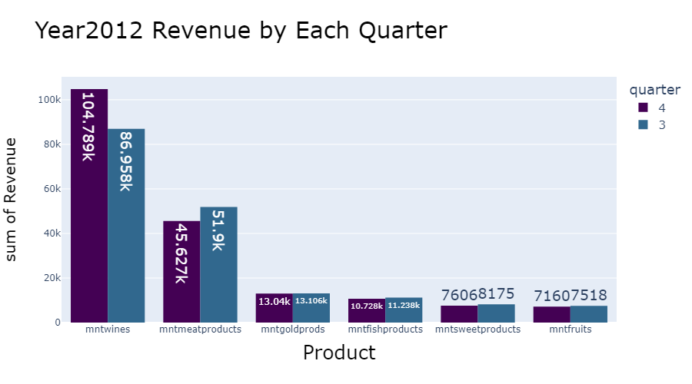
Insight(25):
In Year 2012 : Quarter (4) recorded the highest Revenue of wine Product than Quarter (3).
But Quarter (3) recorded the highest Revenue in Meat Product Than Quarter (4).

Slide 28
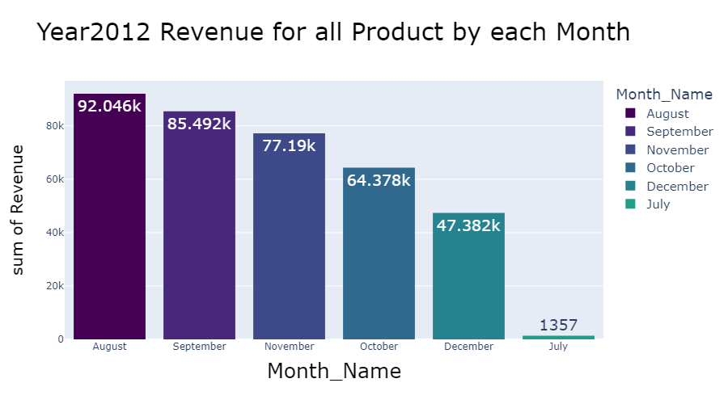
Insight(26):
In year2012 : August Recorded The Highest Revenue for All Products.

Slide 29
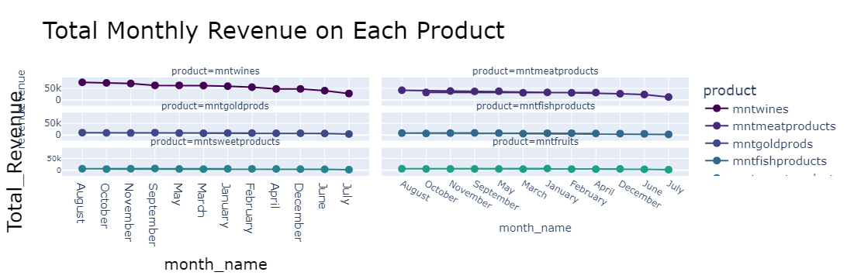
As we see that Credit went to August that recorded The Highest Revenue for each Product.

Slide 30
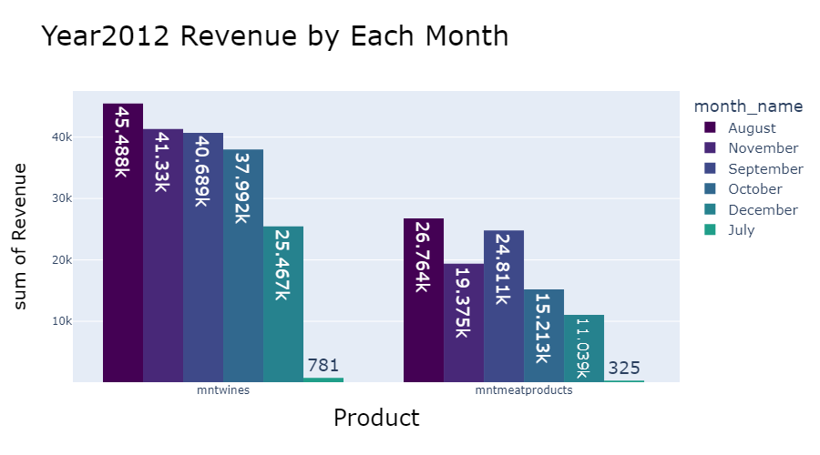
Insight(27):
In Year 2012 : August Recorded the highest revenue in Wine Product,
And Also recorded the highest in Meat Product.

Slide 31
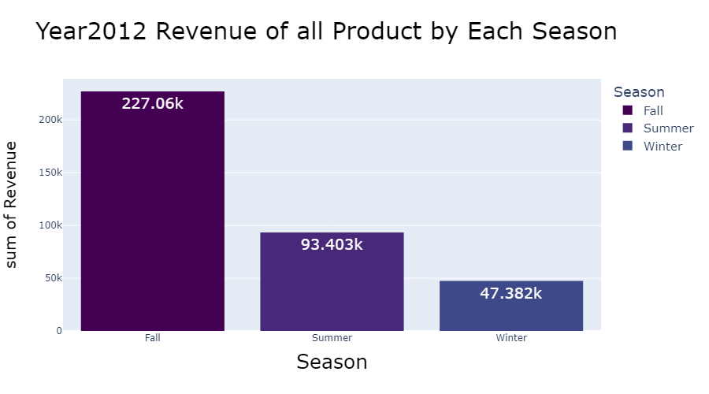
Insight(28):
In Year 2012 : Fall(Sep , Oct, Nov) Season Recorded the highest Revenue for All products.

Slide 32
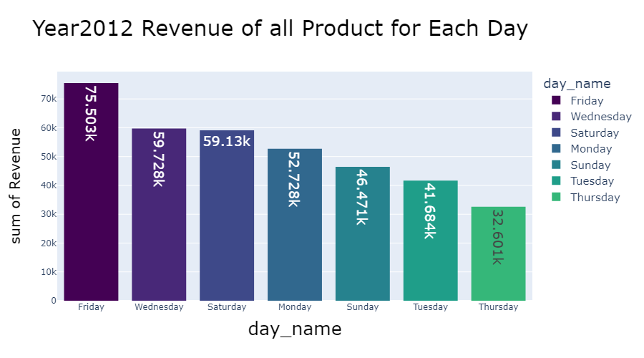
Insight(29):
In Year 2012 : Friday Recorded the Highest Revenue for all Products in our Company.

Slide 33
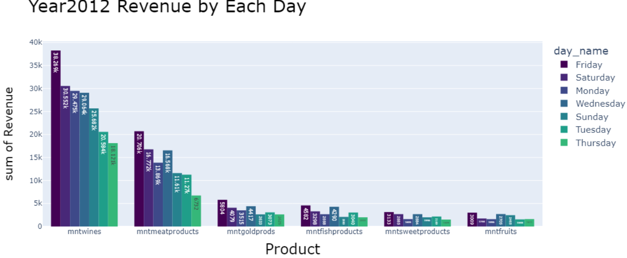
Insight(30):
In Year 2012 : Chart Shaw that each Product Revenue in Each Day.
Wine Recorded the highest in all Days .

Slide 34
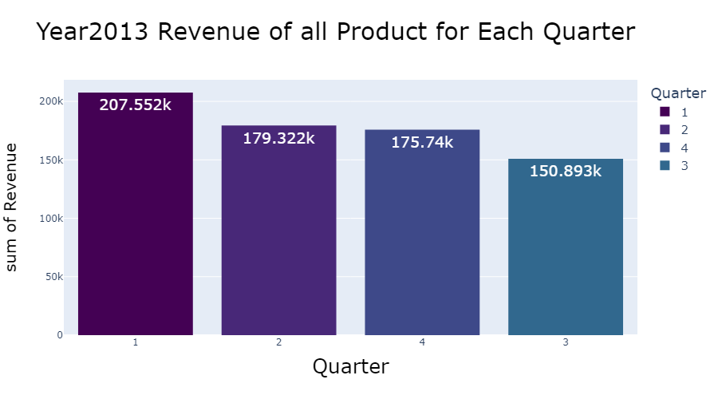
Year (2013)
Insight(31):
In Year 2013 : Quarter(1) Recorded the Highest Revenue for all Products in our Company.

Slide 35
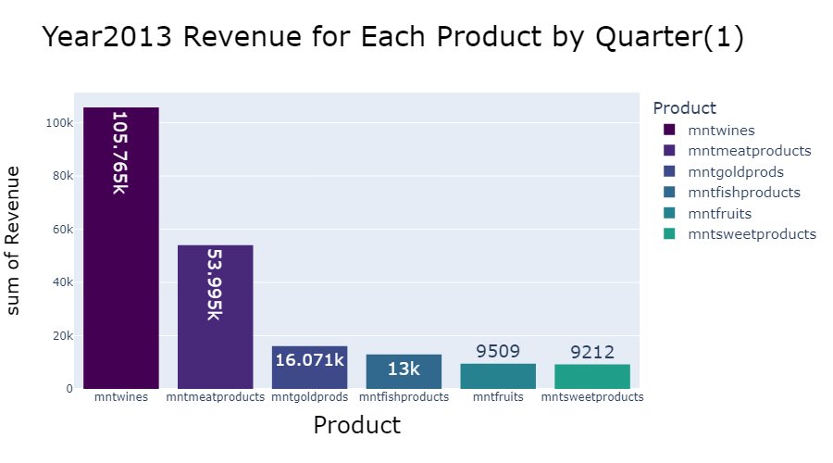
Insight(32):
In Year 2013 : Wine Product Recorded the Highest Revenue in highest Quarter(1) for year 2013.

Slide 36
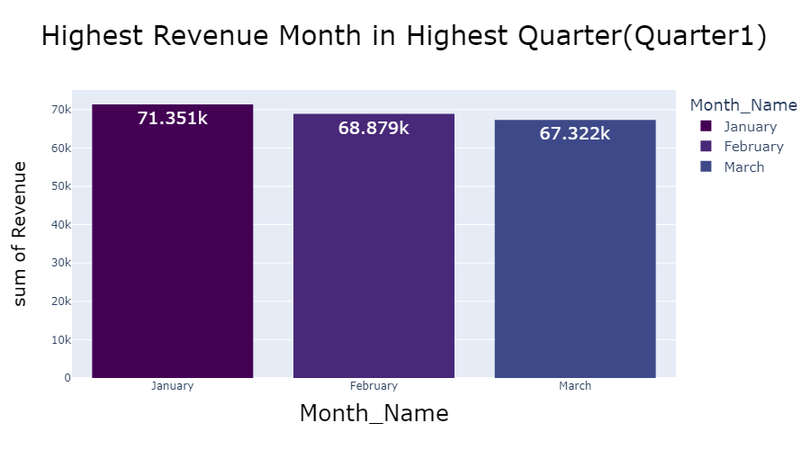
Insight(33):
In Year 2013 : Quarter(1) Recorded the Highest Revenue for all Products in our Company , Also Jan Recorded the Highest Revenue of Months in Quarter(1).

Slide 37
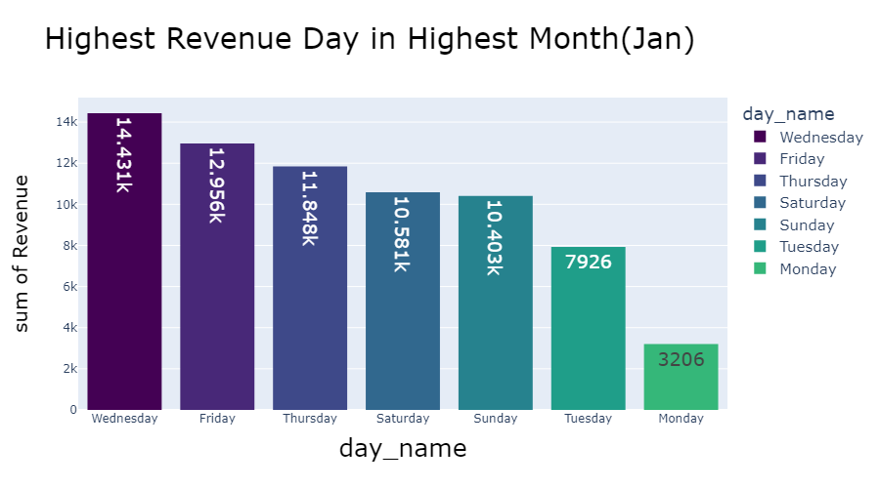
Insight(34):
In Year 2013 : Also Wed. Recorded the highest Revenue for all Product in Highest Month (Jan) in Highest Quarter (1).

Slide 38
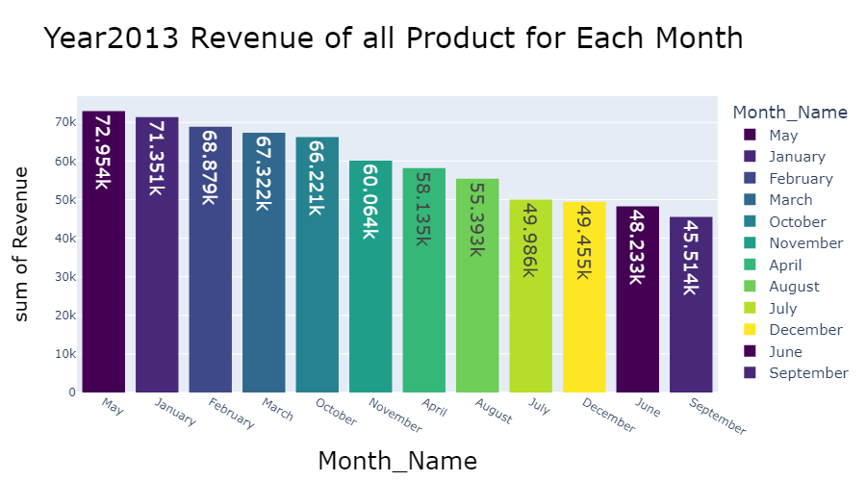
Insight(35):
In Year 2013: Highest Revenue for all Products came from May then Jan.

Slide 39
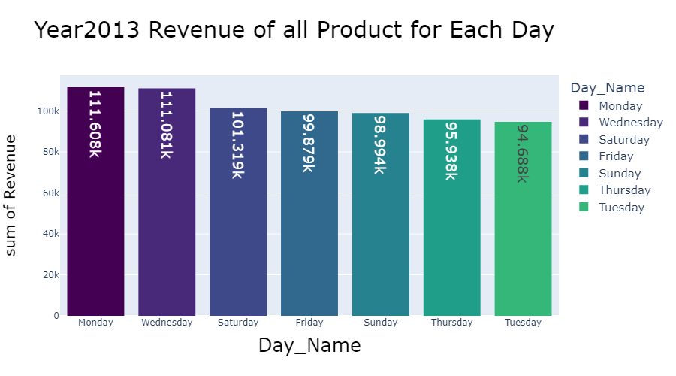
Insight(36):
In Year 2013: Monday Recorded the Highest Revenue in All Product.

Slide 40
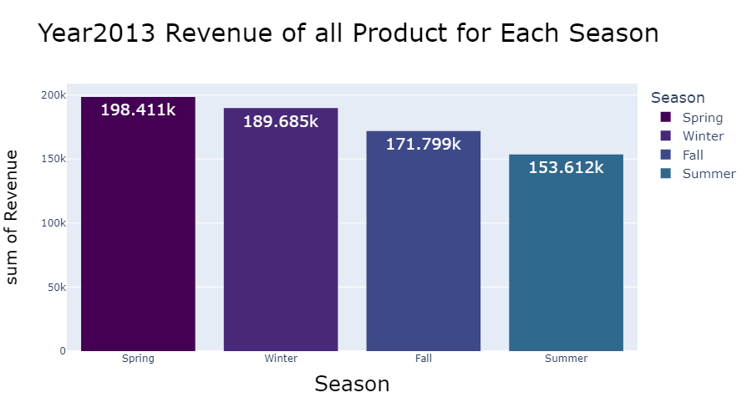
Insight(37):
In Year 2013: Highest Revenue for all Products came from Spring Season.

Slide 41
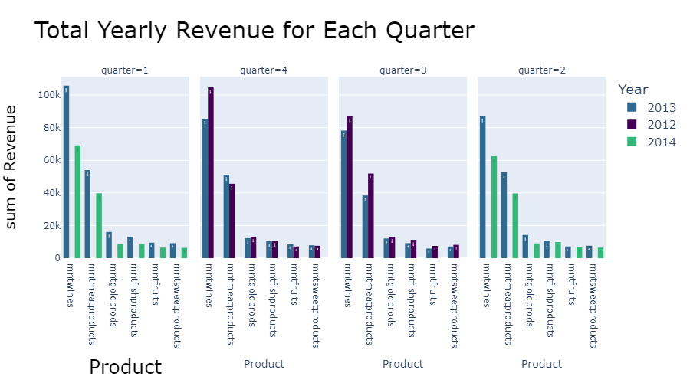
Insight(38):
Quarter(4) Recorded The Highest Revenue For All Products In (2012) Than Quarter(4) In (2013) Except Meat Product.
Quarter(3) Recorded The Highest Revenue For All Products In (2012) Than Quarter(3) In (2013).
Quarter(1) Recorded The Highest Revenue For All Products In (2013) Than Quarter(1) In (2014).
Quarter(2) Recorded The Highest Revenue For All Products In (2013) Than Quarter(2) In (2014).

Slide 42
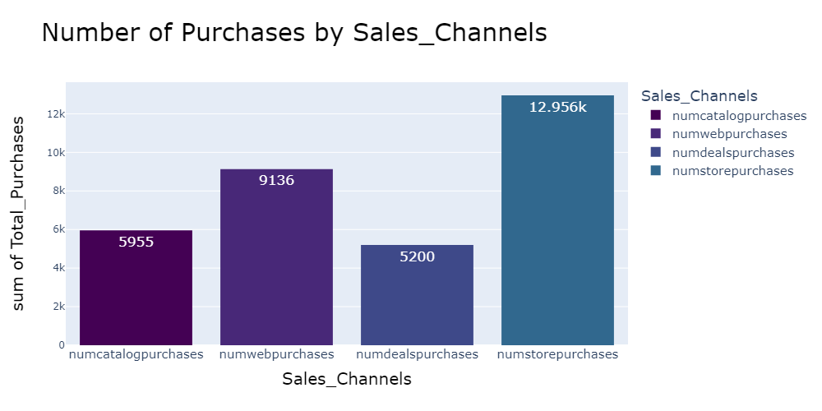
4.Sales_Channel:
Insight (39):
Numbers of Purchases that Made directly from the Store Recorded the Highest with 12.956k .

Slide 43
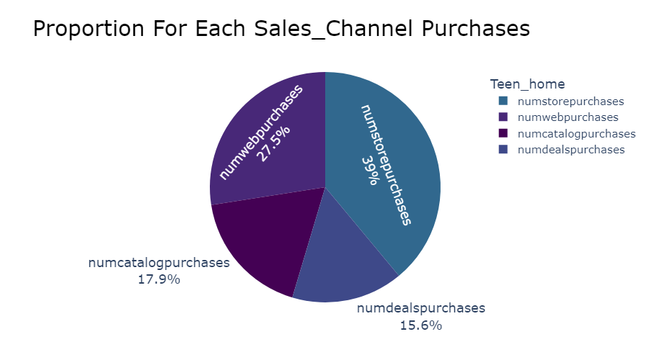
Num of Purchases that Made directly from store Recorded 39% of total Purchases.

Slide 44
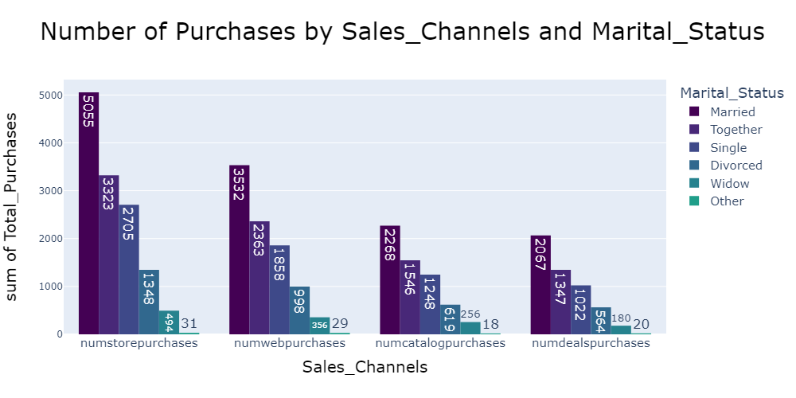
Insight (40):
Married Customers Recorded the highest numbers that made Purchases in all Sales_channels.

Slide 45
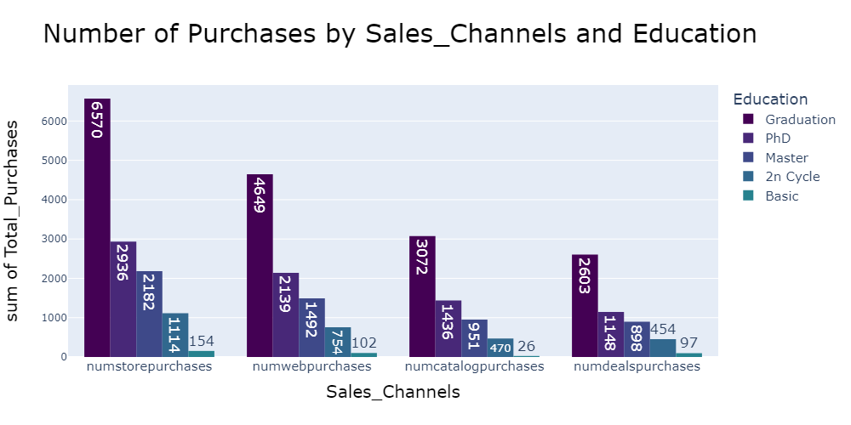
Insight (41):
Customers that are Graduated Recorded the Highest numbers that made Purchases from all Sales_Channels.

Slide 46
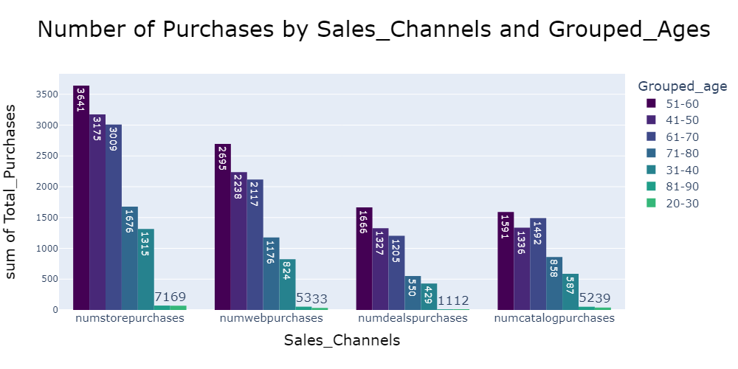
Insight (42):
51-60 Ages Recorded the Highest Numbers that made purchases in all Sales_Channels.

Slide 47
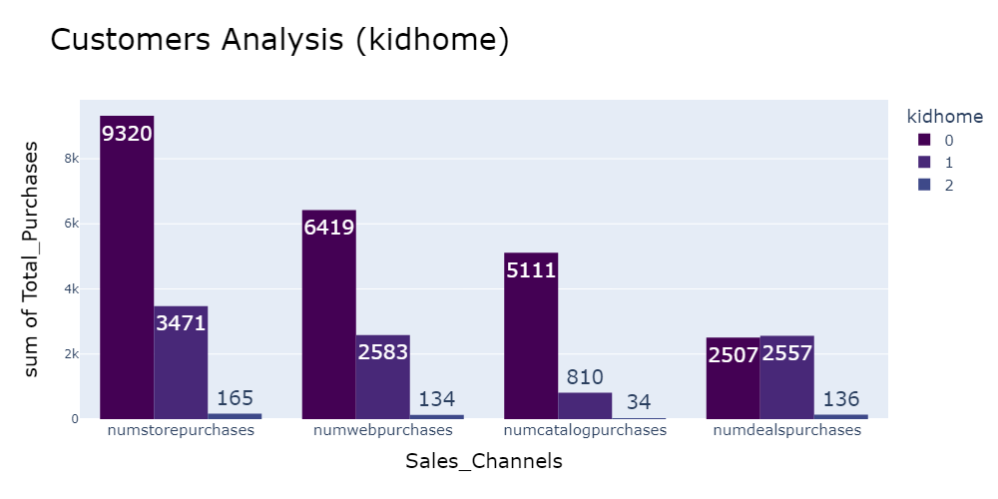
Insight (43):
Customers That Had No Kids Recorded The Highest Number Of Purchases In All Sales_channels.

Slide 48
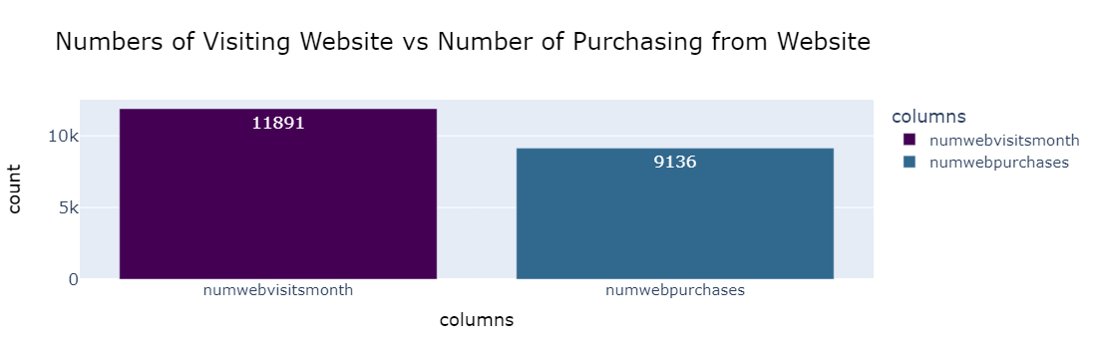
Insight (44):
Customers that Only visit the company website without making Purchases recorded 11891
But Customers that visit and made Purchases recorded 9136

Slide 49
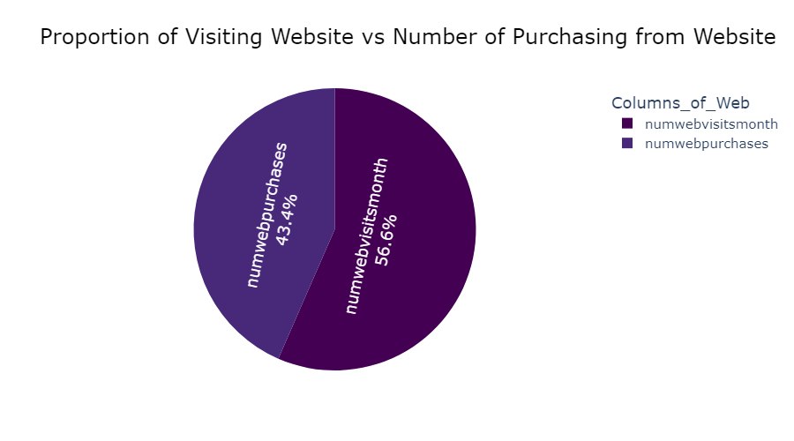
Proportion of Visiting website vs made purchases from website.

Slide 50
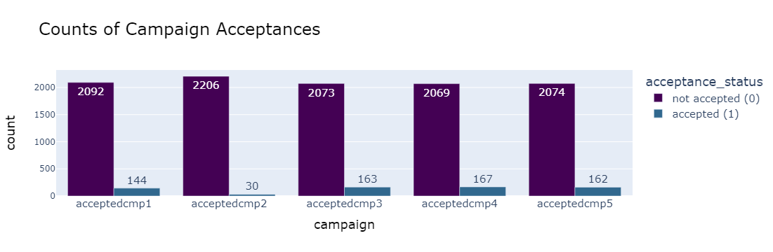
4.Marketing_Campaings:
Insight(45):
For the Previous 5 Campaigns , campaign Num4 recorded the highest of accepted offers in this campaign with 167 .

Slide 51
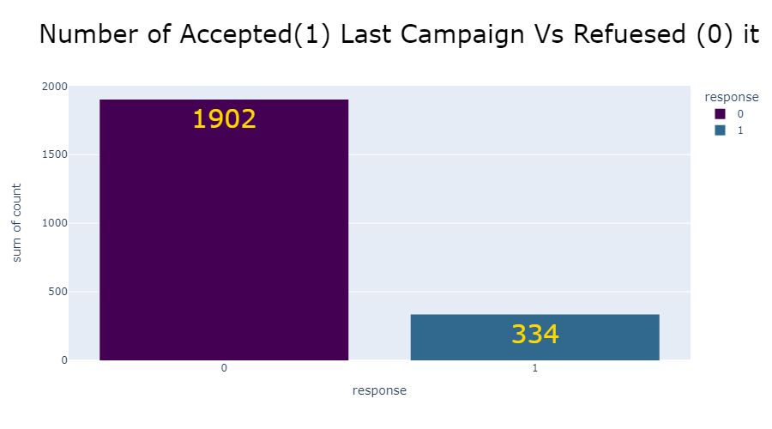
Target : Response
Insight(46):
Last Campaign “Response” Credit the highest Responses “ Yes” with 334 Customers.

Slide 52

Insight(47):
Single Customers Recorded the Highest Number of Customers who Responded with “ Yes” to the last Campaign “ Response”.

Slide 53

Insight(48):
Graduation Ones Recorded the Highest Numbers of Customers who responded with “ Yes” to the Last Campaign.

Slide 54

Insight(49):
51-60 Ages Recorded the Highest Numbers of Customers that Responded with “Yes” for the Last Campaign.

Slide 55

Insight(50):
Spain Recorded the highest Number of Customers who Responded with “Yes” For the Last Campaign.

Slide 56

customer's last interaction
Insight(51):
670 Customers made last Purchases for a very long Time.

Slide 57

Top Seller Details
Insight(52):
Credit went to Married Customers who were the Top_Sellers in Our Company.

Slide 58

Insight(53):
Credit went to Graduation Customers who were the Top_Sellers in Our Company.

Slide 59

Insight(54):
Credit went to 60-70 Customers who were the Top_Sellers in Our Company.

Slide 60

Insight(55):
Credit went to Customers from Spain who were the Top_Sellers in Our Company.

Slide 61
Business suggested Decisions:
1.Customers that only visit the website are much than Customers that visit and made purchases, so I suggest that:
Check traffics on website and made it faster to help customers made more purchases not only visit.
Send special promotions for those who made purchases from the website to encourage them to make more.
2. Married, Graduated Customers Recorded The Highest Revenue For Our Company So I Suggest That: Made Promotions For Those Customers In All Products To Improve Our Revenue
Also, Customers With No-kid Or No-teenagers Recorded The Highest Revenue.
Customers In Spain Recorded The Highest So We Should Know What The Reasons That Make Customers Recorded The Highest Revenue In Spain And Trying To Make It In All Countries To Gain Revenue More Than That.
3. By Year 2012 and 2013 Quarter 3 , 4 Recorded the highest Revenue in 2012 than 2013 so I suggest that :
In the upcoming Campaigns go backwards to Quarter 3, 4 in Year 2012 to know what affects on Revenue to remake it again for achieving the same Revenue or maybe the improved version.
4. By Year 2013 and 2014 Quarter 1 , 2 Recorded the highest Revenue in 2013 than year 2014 so I suggest that :
In the upcoming Campaigns go backwards to Quarter 1, 2 in Year 2013 to know what affects on Revenue to remake it again for achieving the same Revenue or maybe the improved version.

Slide 62
5. Number of purchases direct from store recorded the highest so I suggest that:
to make something special in Store to Encourage Customers to make more purchases.
Improve other channels like Catalog , Website , or even made different Promotion in all those channels to ensure that Purchases will made in all.
6. Single, Graduations,51-60 ages and Spain country ‘ Customers whose responded with yes in the last campaign ,I suggest to make survey for our customers to know why they accept or refuse the response for campaigns and suggest for company what they want about products , promotions and so on.
7.Best Sellers Customers who made last purchases around 0 to only one week :
Married , Graduation , 61-70 ages , Spain Recorded the Highest Numbers of Customers
So First , we want to make special offers for those ones to improve the revenue.
Second, we should send other promotions to those who made purchases long time terms .
8. Try To Make Different Campaigns So That Response On It Affect The Target You Want, Knows Why Most Of Our Customers Refused The Offers In Our Company To Fix That Issues So That Gain More Customers So That More Responses And Also More Revenue.

Slide 63
The End

